Slide 1
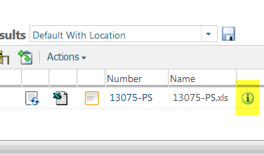
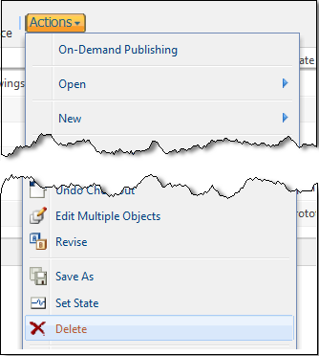
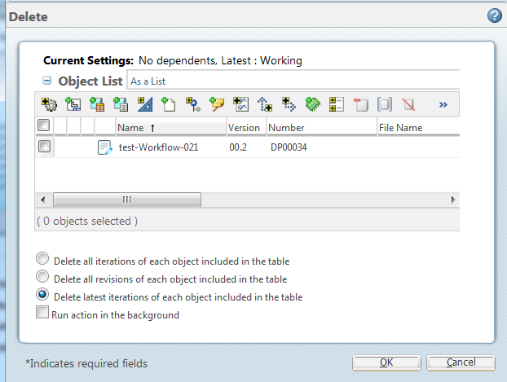



How to Delete latest iteration in Windchill
a. Find your document and click the info page button.
1 Find Doc
a
b. Click Actions.
c. Select Delete.
b
2 Action
c
In the save dialog box:
d. Choose “Delete latest iterations..”
e. Click OK
CAUTION: Choosing “Delete all revision…” will totally remove the object from Windchill.
3 Delete
d
e
Tool Tips
If your objective is to delete the latest Revision with all its iteration. Select “Delete all iterations of …”
NOTE: You cannot delete files that have a Released status.

